Slide 1

Knee Osteoarthritis Detection and its Severity using
Deep Learning
Batch - 03:
V.Navya Venkata Sai 19P31A1253
Ankit Kumar 19P31A1203
K.Hari Chaitanya 19P31A1219
V.Balaji 19P31A1254
Guide:
M.M.Siva Krishna
Assistant Professor

Slide 2
CONTENTS
BACKGROUND STUDY
INTRODUCTION
BASIC REQUIREMENTS
DATASET STRUCTURE
WORKING
CNN ALGORITHM
TRANSFER LEARNING
ACCURACY AND LOSS FOR ALL MODELS
PURPOSE OF THE SYSTEM
SCOPE OF THE SYSTEM
EXISTING SYSTEM
PROPOSED SYSTEM
SYSTEM REQUIREMENTS
SYSTEM ANALYSIS
ADVANTAGES
CONCLUSION

Slide 3
BACKGROUND/PROBLEM STATEMENT:
Arthritis is a disorder that causes swelling, tenderness, inflammation, stiffness etc. in one or more joints. Arthritis is more common in older people and typically worsens with age. While there are many different types of arthritis with different causes and treatments, osteoarthritis is the most prevalent. Osteoarthritis is estimated to affect nearly 237 million people globally, this accounts for almost 3.3% of the human population.
The Knee Osteoarthritis Detection helps patients detect Osteoarthritis in their knees. Along with helping with early detection, this also detects the severity of the disorder.

Slide 4
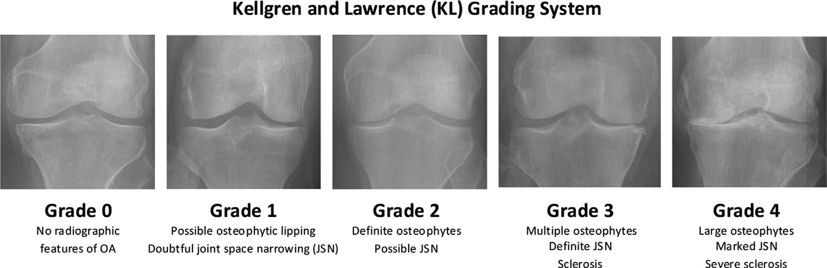
INTRODUCTION:
Elderly people, obese people, and people who lead sedentary lifestyles are more likely to develop knee OA. When it is advanced, it produces intense agony and frequently results in total joint arthoplasty. Early diagnosis is essential for pathology and therapeutic therapies.X-ray has been taken as the gold standard for the knee OA screening.Kellgren and Lawrence (KL)is a grading system used for knee OA severity. KL system splits knee OA severity into 5 grades from grade 0 to grade

Slide 5
DEEP LEARNING
Definition: Deep learning is a type of machine learning that uses algorithms meant to function in a manner similar to the human brain.
Deep learning is a subset of machine learning, which is essentially a neural network with three or more layers. While a neural network with a single layer can still make approximate predictions, additional hidden layers can help to optimize and refine for accuracy.
Many recent advances in AI were made possible by deep learning. From recommendations on streaming services to voice assistant technologies to autonomous driving, the ability to identify patterns and classify many different types of information is crucial for processing vast amounts of data

Slide 6
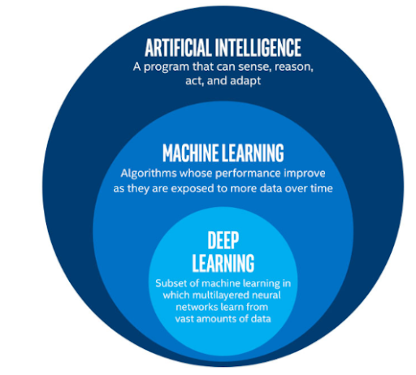
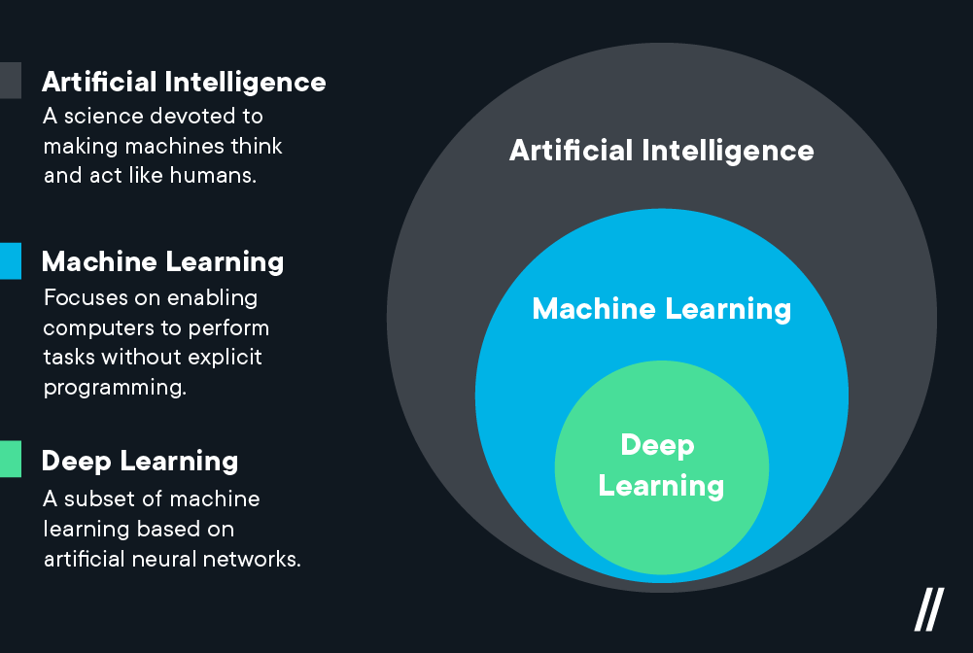

Slide 7


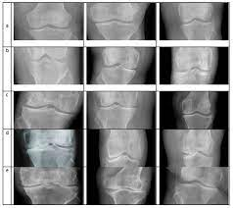
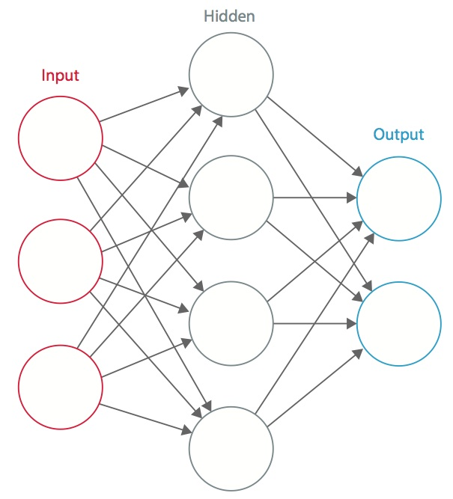
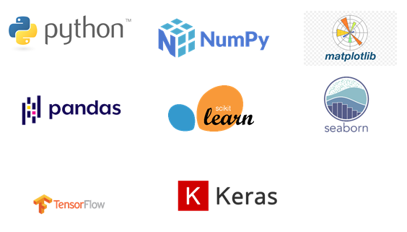
BASIC REQUIREMENTS:
Dataset
CNN Algorithm & Transfer Learning Models
Python
Jupyter
keras and tensorflow

Slide 8
DATASET STRUCTURE:
ARCHIVE
TEST
TRAIN
VALIDATION
0 (639)
1 (296)
2 (447)
3 (223)
4 (51)
Total:1656
0 (2286)
1 (1046)
2 (1516)
3 (757)
4 (173)
Total:5778
0 (328)
1 (153)
2 (212)
3 (106)
4 (27)
Total:826
Total Dataset Size:8260 Images

Slide 9
WORKING:
We first train the datasets. We have 5 classes of images and after training by CNN algorithm and various transfer learning models used in this project, we have different convolutional layers forming on it and after each layer, the precision keeps increases. How many layers being used depends upon the number of epochs used. More the number of epochs, more the precision.
Once the x-ray dataset has been uploaded, the images undergoes resizing and colour change from gray to RGB colors and then there several convolutional layers applied on it by the help of CNN algorithm and used various transfer learning models for detection of knee OA and also specify the severity of the knee.

Slide 10

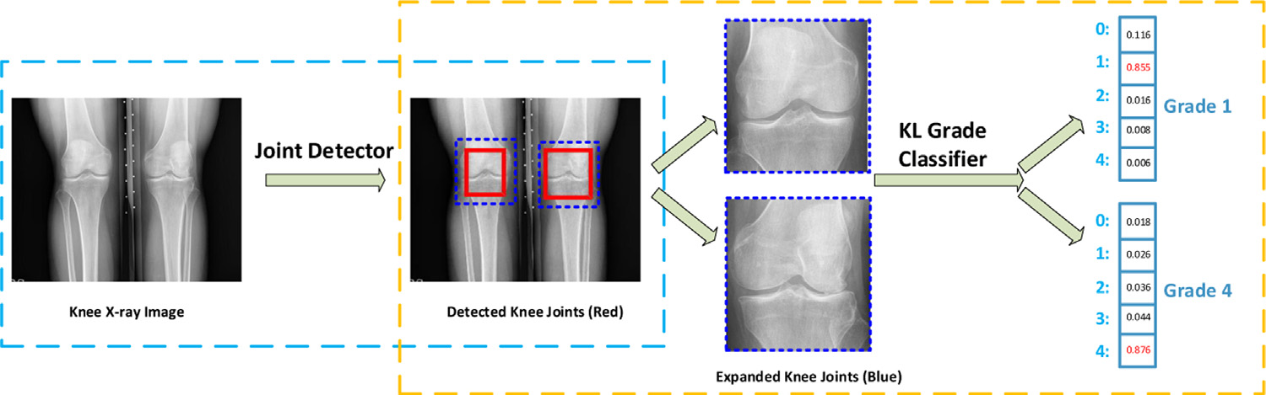
CNN ALGORITHM:
A Convolutional Neural Network (CNN) is a Deep Learning algorithm which can take in an input image, assign importance (learnable weights and biases) to various aspects/objects in the image and be able to differentiate one from the other.

Slide 11
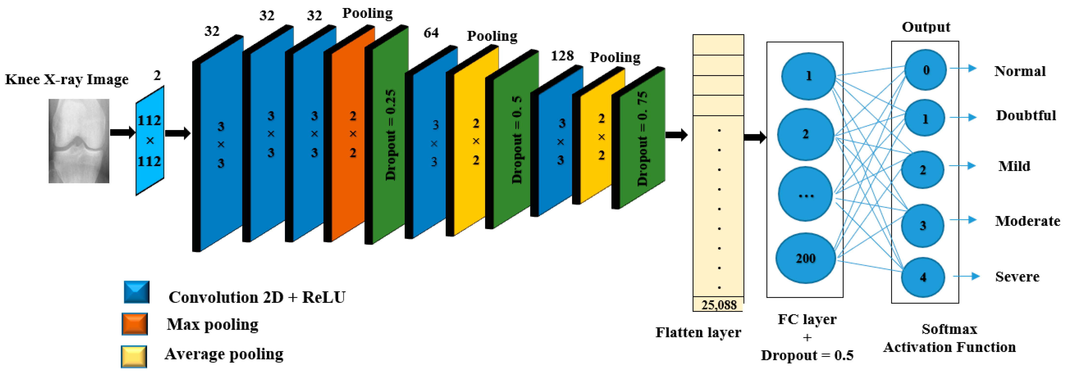

Slide 12
kernel:
It is a filter used extract the features from image.
size(output)=[size(input)-size(kernel)]+1
2.stride:
It is a movement across the image.
size(output)=[size(input)-size(kernal)/size(stride)]+1
3.padding:
It is also known as border problem solver
size(output)=[size(input)-size(kernal)+2p/size(stride)]+1
4.flatten:
It converts a matrix into a one dimensional column for neural network.

Slide 13
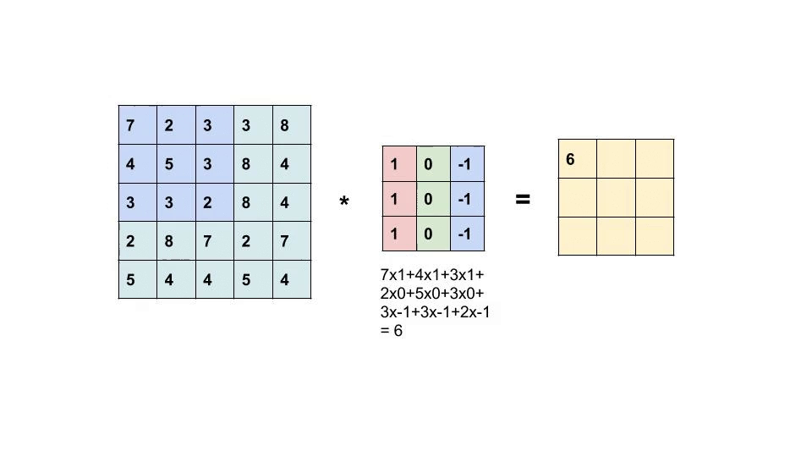
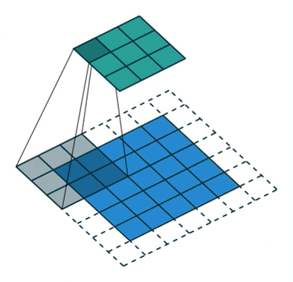
Input * Kernel = Output Padding:

Slide 14
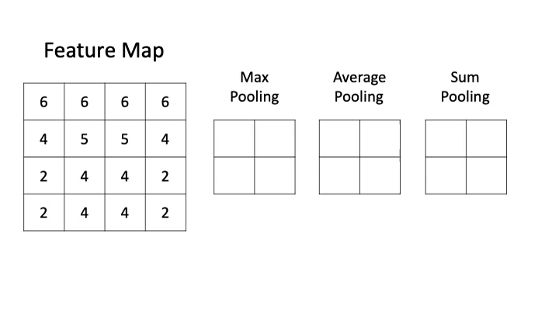
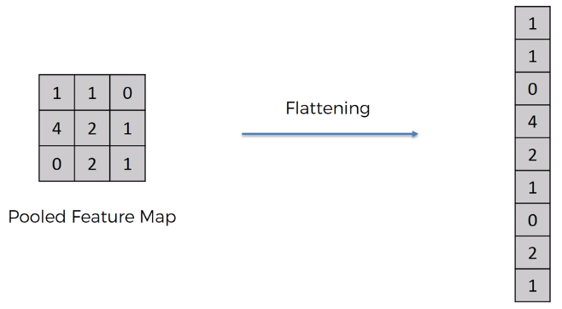
Pooling: Flattening:

Slide 15
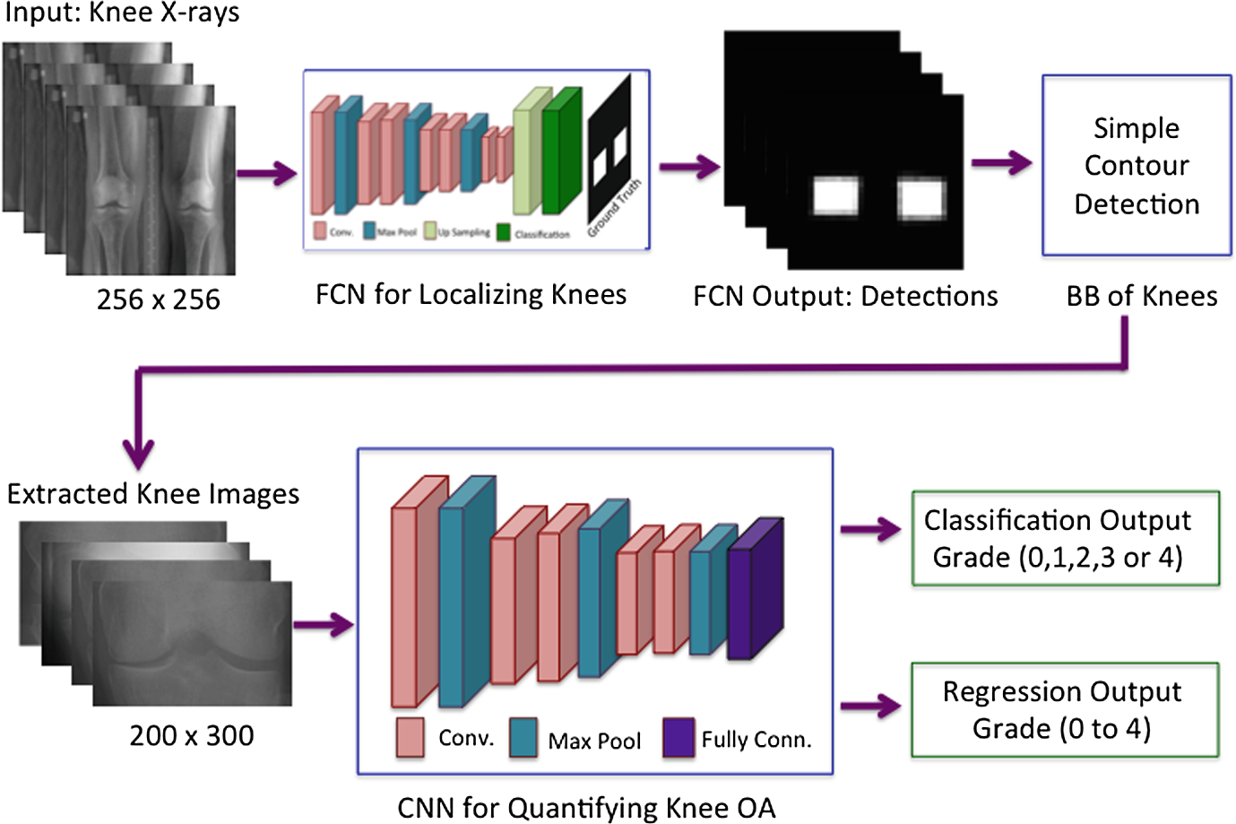
Architecture of the CNN Methodology:

Slide 16
TRANSFER LEARNING:
The reuse of a pre-trained model on a new problem is known as transfer learning in machine learning. A machine uses the knowledge learned from a prior assignment to increase prediction about a new task in transfer learning.
The knowledge of an already trained machine learning model is transferred to a different but closely linked problem throughout transfer learning.
By applying transfer learning to a new task, one can achieve significantly higher performance than training with only a small amount of data. Transfer learning is so common that it is rare to train a model for an image or natural language processing-related tasks from scratch.

Slide 17
Traditional CNN vs Transfer Learning
Traditional CNN model require training from scratch, which is computationally expensive and requires a large amount of data to achieve high performance. On the other hand, transfer learning is computationally efficient and helps achieve better results using a small data set. 
Traditional CNN has an isolated training approach where each model is independently trained for a specific purpose, without any dependency on past knowledge. Contrary transfer learning uses knowledge acquired from the pre-trained model to proceed with the task.
Transfer learning models achieve optimal performance faster than the traditional CNN model. It is because the models that leverage knowledge (features, weights, etc.) from previously trained models already understand the features. It makes it faster than training neural networksfrom scratch.

Slide 18
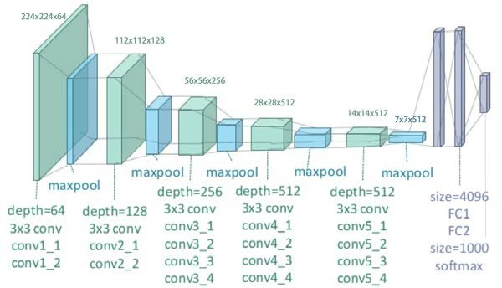
VGG19 MODEL
VGG also known as VGGNet, a classical convolutional neural network (CNN) architecture. VGG was developed to increase the depth of such CNNs in order to increase the model performance.
It is one among the transfer learning mechanisms.

Slide 19
What is VGG19?
VGG stands for Visual Geometry Group; it is a standard deep Convolutional Neural Network (CNN) architecture with multiple layers. The“deep” refers to the number of layers with VGG-19 consisting of 19 convolutional layers.
Transfer learning provides a very effective idea to solve the above problems of deep learning. It uses a pretrained deep convolutional neural network that has been trained on another dataset.

Slide 20
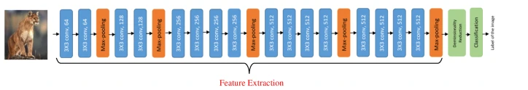
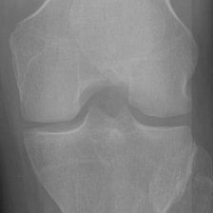
Uses of the VGG Neural Network
VGG19 proposed by Simonyan and Zisserman (2014) is a convolutional neural network that comprises 19 layers with 16 convolution layers and 3 fully connected to classify the images
It is a very popular method for image classification due to the use of multiple 3 × 3 filters in each convolutional layer.
An image of size 224 × 224 is inputted into this model and the model outputs the label of the object in the image.

Slide 21
CNN stands for Convolutional Neural Network, which is a type of artificial neural network commonly used in image recognition and classification tasks. VGG19, on the other hand, is a specific CNN architecture developed by the Visual Geometry Group at the University of Oxford.
Here are some key differences between CNN and VGG19:
Architecture: CNN is a broad term that refers to a family of neural network architectures that use convolutional layers. VGG19 is a specific architecture within this family, and it has a particular structure that includes 19 layers.

Slide 22
Depth: VGG19 is a deeper network than many other CNN architectures, including some of its predecessors like AlexNet. The depth of VGG19 allows it to learn more complex features and patterns in images.
Pooling Layers: VGG19 also includes five max pooling layers, which are used to downsample the feature maps produced by the convolutional layers. This helps to reduce the size of the model and make it more efficient.
Fully Connected Layers: VGG19 has three fully connected layers at the end of the network, which are used to classify the images. These layers take the features extracted by the convolutional layers and use them to make predictions about the class of the input image.

Slide 23
5. Convolutional Layers: VGG19 has 16 convolutional layers, which are used to extract features from images. Each convolutional layer is followed by a ReLU activation function, which introduces non-linearity into the model.
Overall, VGG19 is a specific type of CNN that is known for its depth and its ability to extract complex features from images. It has a particular architecture that includes 16 convolutional layers, five max pooling layers, and three fully connected layers.

Slide 24
VGG16 MODEL
VGG16 refers to the VGG model, also called VGGNet. It is a convolution neural network (CNN) model supporting 16 layers. K. Simonyan and A. Zisserman from Oxford University proposed this model and published it in a paper called Very Deep Convolutional Networks for Large-Scale Image Recognition.A VGG network consists of small convolution filters. VGG16 has three fully connected layers and 13 convolutional layers.
Begin by importing VGG16 from keras. applications and provide the input image size. Weights are directly imported from the ImageNet classification problem. When top=False, it means to discard the weights of the input layer and the output layer as you will use your own inputs and outputs.

Slide 25
Here are some key differences between CNN and VGG16:
Architecture: CNN is a broad term that refers to a family of neural network architectures that use convolutional layers. VGG16 is a specific architecture within this family, and it has a particular structure that includes 16 layers.
Depth: VGG16 is a deeper network than many other CNN architectures. The depth of VGG16 allows it to learn more complex features and patterns in images as same as VGG19.
Pooling Layers: A pooling layer follows several convolutional layers this helps reduce the dimensionality and the number of parameters of the feature maps created by

Slide 26
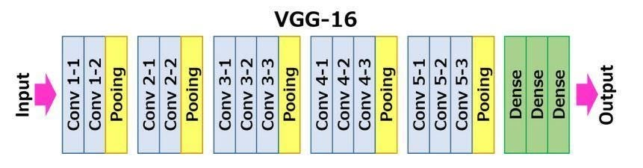
Fully Connected Layers: VGG16 includes three fully connected layers. The first two layers each have 4096 channels, and the third layer has 1000 channels, one for every class.
Convolutional Layers: VGG16 has 13 convolutional layers, which are used to extract features from images. Each convolutional layer is followed by a ReLU activation function, which introduces non-linearity into the model.

Slide 27
RESNET50 MODEL
ResNet stands for Residual Network and is a specific type of convolutional neural network (CNN) introduced in the 2015 paper “Deep Residual Learning for Image Recognition” by He Kaiming, Zhang Xiangyu, Ren Shaoqing, and Sun Jian.
ResNet-50 is a 50-layer convolutional neural network (48 convolutional layers, one MaxPool layer, and one average pool layer). Residual neural networks are a type of artificial neural network (ANN) that forms networks by stacking residual blocks.
The ResNet architecture follows two basic design rules. First, the number of filters in each layer is the same depending on the size of the output feature map. Second, if the feature map’s size is halved, it has double the number of filters to maintain the time complexity of each layer.

Slide 28
INCEPTION V3
Inception v3 is a convolutional neural network for assisting in image analysis and object detection, and got its start as a module for GoogLeNet. It is the third edition of Google's Inception Convolutional Neural Network, originally introduced during the ImageNet Recognition Challenge.
The design of Inceptionv3 was intended to allow deeper networks while also keeping the number of parameters from growing too large.
The model itself is made up of symmetric and asymmetric building blocks, including convolutions, average pooling, max pooling, concatenations, dropouts, and fully connected layers. Batch normalization is used extensively throughout the model and applied to activation inputs. Loss is computed using Softmax.

Slide 29
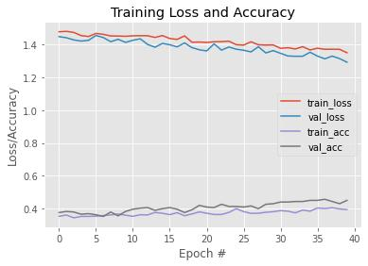
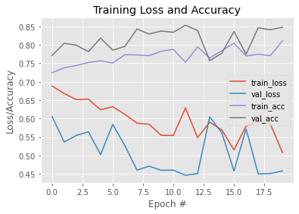
Plots of training,testing loss and accuracy :
CNN with epochs=40 VGG19 with epochs=20

Slide 30
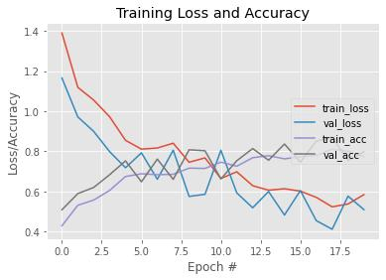
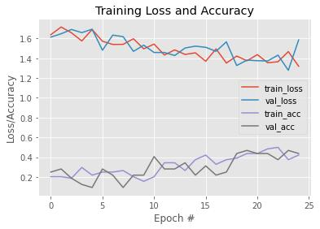
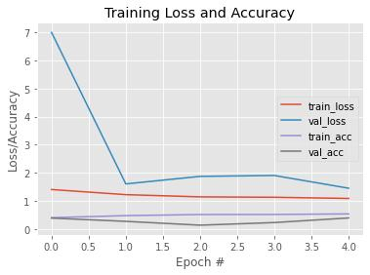
VGG16 With 20 Epochs
INCEPTION V3 With 20 Epochs
RESNET50 With 20 Epochs

Slide 31
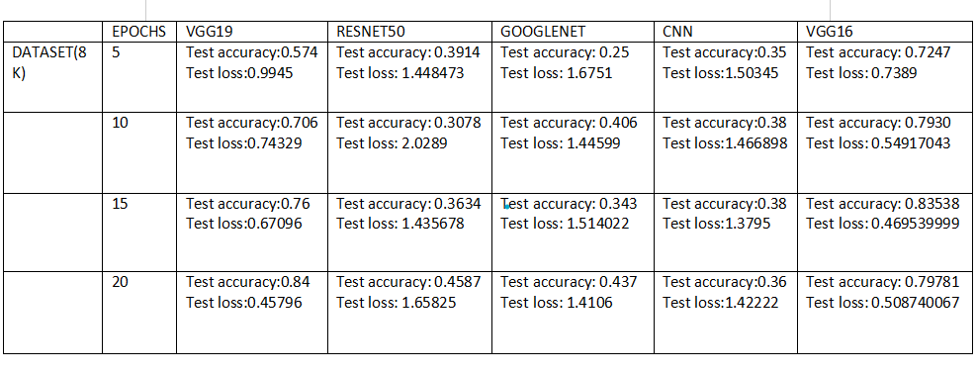
ACCURACY AND LOSS FOR ALL MODELS:

Slide 32
Purpose of the system:
The Knee Osteoarthritis Detection helps doctors and patient to detect Osteoarthritis in their knees. Along with helping with early detection, this application also detects the severity of the disorder.This is a fresh method for using X-ray pictures to automatically measure the severity of knee OA.
Scope of the System:
Based on the X- rays detecting the knee OA.
The aim is to apply deep learning in detecting the knee OA and its stage .

Slide 33
Existing System:
In the existing system it become more difficult to accuratley predict or detect the severity of knee osteoarthrities.(X-ray) has been traditionally preferred, and remains the main accessible tool for preliminary knee OA diagnosis.
Proposed System:
This is a fresh method for using X-ray pictures to automatically measure the severity of knee OA. Two stages are required to automatically determine the severity of knee OA: initially, naturally Localizing the knee joints, then categorising the photos of the localised knee joints using CNN model.
Along with CNN model we also used various transfer learning models for better accuracy.

Slide 34
SYSTEM REQUIREMENTS:
FUNCTIONAL REQUIREMENTS
1. Software Requirements:
◆ Operating System - Windows (version - 11)
◆ IDE – Jupyter Notebook
2. Hardware Requirements:
◆ Processor - Intel i5
◆ Ram - 8GB
◆ Hard Disk - 2GB
◆ System Type - 64 bit
◆ Grapic card - 2GB

Slide 35
Usability:
This is used to Detect the Knee Osteoarthritis helps patients detect Osteoarthritis in their knees. Along with helping with early detection, this web application also detects the severity of the disorder.
Reliability:
◆ This system is used to make accuracy between different models,thus it has high Reliability with value lying between 0 and 1.
Performance:
◆ As it makes uses an algorithm along with x-rays it help us to make the system having high performance output.
non FUNCTIONAL REQUIREMENTS

Slide 36
Portability:
Since the deep learning code is written in python language which is having rich library functions it is more portable.
Resource Requirements: 
Required software is to be installed like spyder and respected libraries like tensorflow,keras,numpy, and sklearn are to be installed in our system to execute our project successfully.

Slide 37
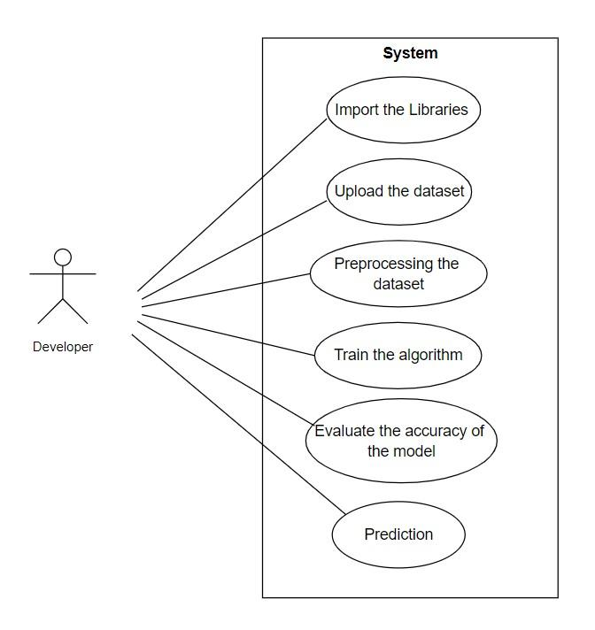
SYSTEM ANALYSIS: Use case diagrams
The Usecase diagram is a graphic that is used to define the core elements and processes that make up a system. The key elements are termed as "actors" and the processes are called "actions".
It shows which actors interact with each usecase. Usecase diagrams are created to visualize the relationship between actors and usecases. A usecase is a pattern of behaviour the system exhibits.

Slide 38
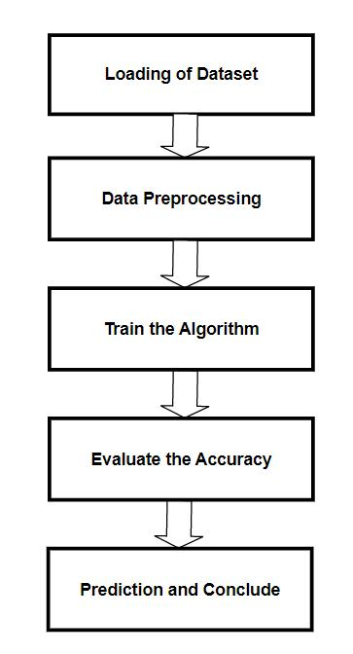
SYSTEM DESIGN SYSTEM ARCHITECHTURE
A system architecture, sometimes known as a systems architecture, is a conceptual model that describes a system's behaviour, structure, and other aspects.
A description and representation of a system's architecture that is set up to facilitate analysis of a system's behaviour and structure.

Slide 39
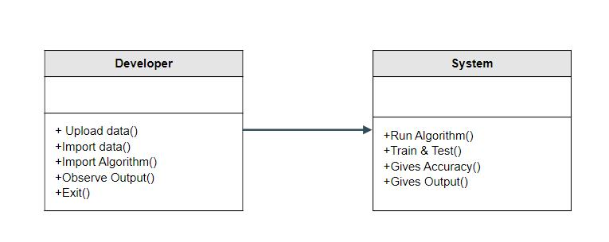
CLASS DIAGRAM
A Class diagrams describe the static structure of a system, or how it is structured rather than how it behaves.
Class diagram gives an overview of a system by showing its classes and the relationships among them. 
UML class is a rectangle divided into: class name, attributes, and operations.

Slide 40
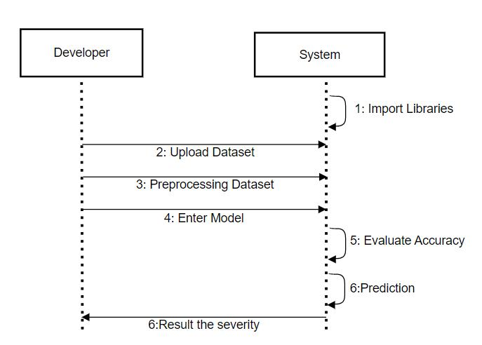
SEQUENCE DIAGRAM
A sequence diagram is a type of interaction diagram because it describes how and in what order a group of objects works together.
Sequence Diagrams are graphs of relationships which describe how activities are done.

Slide 41
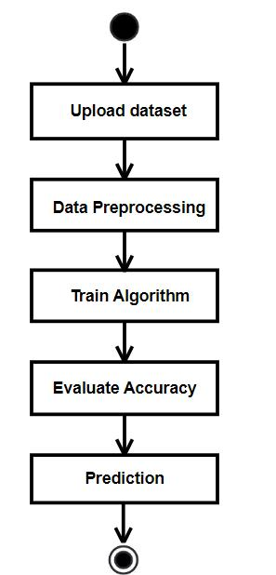
ACTIVITY DIAGRAM
An activity diagram is essentially a flowchart that shows how one activity leads to another.
The action might be referred to as a system operation.
Activity diagrams are used to build the executable system utilizing forward and reverse engineering approaches, as well as to visualize the dynamic nature of a system. Activity is a specific system operation.

Slide 42
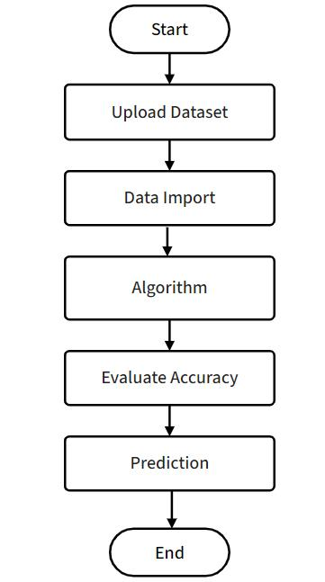
STATE CHART DIAGRAM
An state chart diagram is basically a flowchart to represent the flow from one state to another state.
This flow can be sequential,branched, or concurrent. State chart diagrams deal with all type of flow control by using different elements such as join, etc.

Slide 43
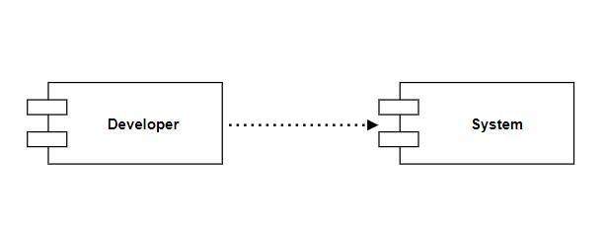
COMPONENT DIAGRAM
Component diagrams are used in modelling the physical aspects of object oriented systems that are used for visualizing, specifying, and documenting component-based systems and also for constructing executable systems through forward and reverse engineering

Slide 44
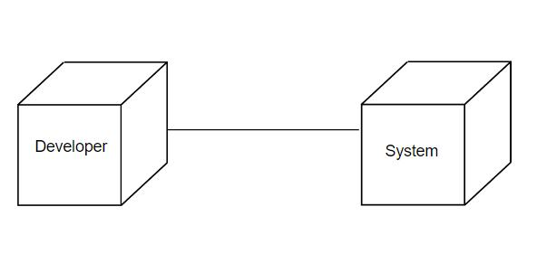
DEPLOYMENT DIAGRAM
Deployment diagrams are used to visualize the topology of the physical components of a system, where the software components are deployed. Deployment diagrams are used to describe the static deployment view of a system. Deployment diagrams consist of nodes and their relationship.

Slide 45
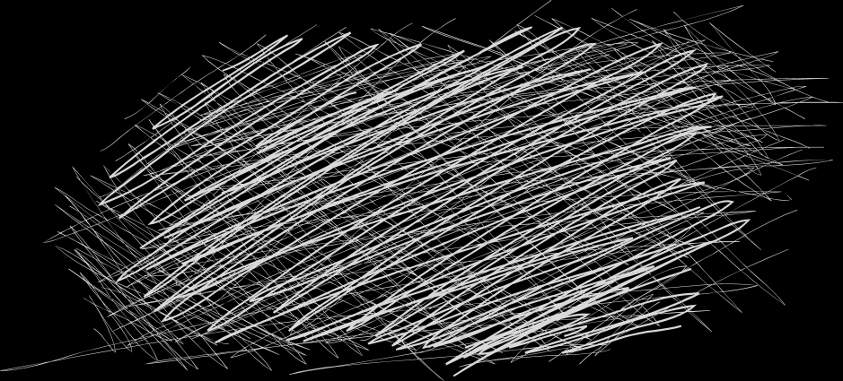
ADVANTAGES:
Helps with instantly detecting signs of Osteoarthritis in knees.
This system even informs about the severity of arthritis.
Optimized and accurate detection
Easy to Use and Easily understandable

Slide 46
CONCLUSION:
We have consider the Knee X-ray Images for the Knee Osteoarthritis Detection and its Severity using various models like convolutional neural network and transfer learning algorithms of CNN.We have observed the working of each and every model which are been used in our project.In the implementation phase we have started working with CNN algorithm and we got 46% accuracy and later we have worked on various transfer learning methodologies like resnet50,inception v3 ,vgg16,vgg19.On using of resnet50 model we got 39% accuracy comparatively lower than CNN model.Respectively, on usage of the models like Inception V3,VGG16,VGG19 we have secured 43%,83% and 84% accuracies.
We choose VGG19 and VGG16 as our final models because they achieved the highest accuracy score with 84% and 83% on validation sets.Additionally,the models were able to predict the new image into its corresponding severity degree and had good generalization performances.We also consulted domain experts,who confirmed that the VGG models was a suitable choice for this problem. In conclusion, we selected the VGGs as our final models for knee OA detection and its severity.

Slide 47
THANK YOU

